Slide 1
Berühmte Migranten in den USA
Wer ist das?

Slide 2
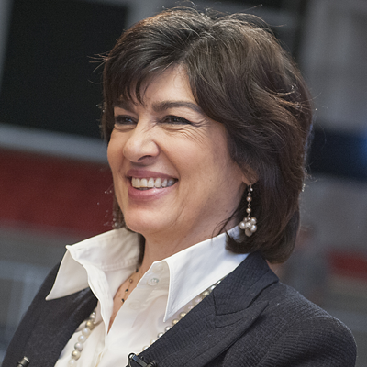
Das ist … ?
Wer ist das?
Das ist Christiane Amanpour.
Woher kommt sie?
- Sie kommt aus England und dem Iran.
“Marie Colvin Distinguished Lecture Series: Christine Amanpour” by Stony Brook University licensed under All Rights Reserved. https://www.flickr.com/photos/10009696@N05/799154752. Last accessed 7/14/2017.

Slide 3
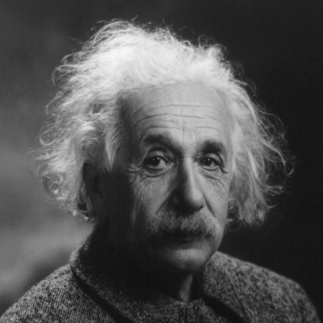
Das ist … ?
Wer ist das?
Das ist Albert Einstein.
Er war ein Physiker.
Woher kam er?
- Er kam aus Deutschland.
“Albert Einstein” by nguyenhaquan licensed under All Rights Reserved. https://www.flickr.com/photos/10009696@N05/799154752. Last accessed 7/14/2017.

Slide 4
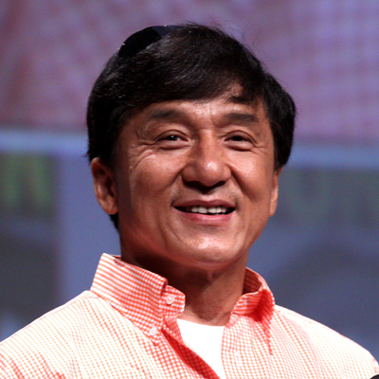
Das ist … ?
“Jackie Chan” by Gage Skidmore licensed under CC BY SA 2.0. https://www.flickr.com/photos/gageskidmore/7588079892. Last accessed 7/14/2017.
Jackie Chan

Slide 5
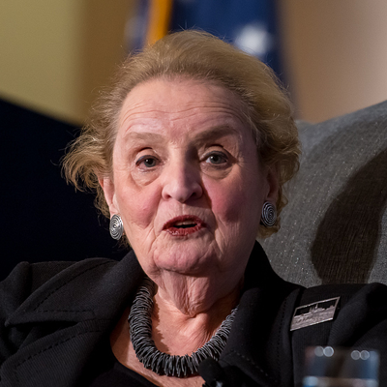
Das ist … ?
“Madeleine Albright at Commonwealth Club of California” by Commonwealth Club licensed under CC BY 2.0. https://www.flickr.com/photos/commonwealthclub/8510904774. Last accessed 7/14/2017.
Madeleine Albright

Slide 6
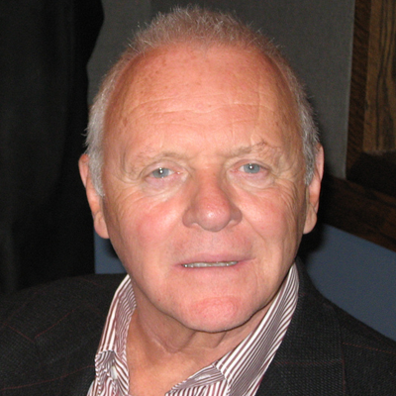
Das ist … ?
“Anthony Hopkins” by WNYC New York Public Radio licensed under CC BY NC 2.0. https://www.flickr.com/photos/wnyc/1764065571. Last accessed 7/14/2017.
Anthony Hopkins

Slide 7
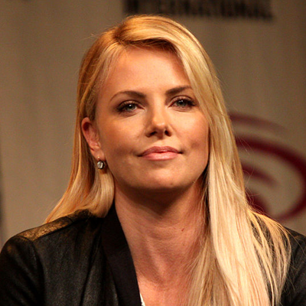
Das ist … ?
“Charlize Theron speaking at the 2012 Wondercon in Anaheim. California” by Gage Skidmore licensed under CC BY SA 2.0. https://upload.wikimedia.org/wikipedia/commons/thumb/7/78/Charlize_Theron_%286852646838%29.jpg/1280px-Charlize_Theron_%286852646838%29.jpg. Last accessed 7/14/2017.
Charlize Theron

Slide 8
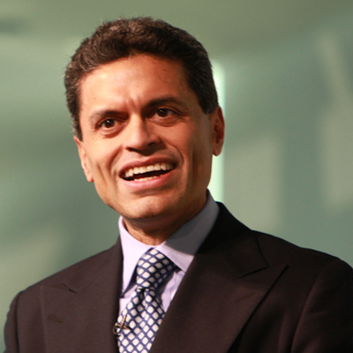
Das ist … ?
“Fareed Zakaria” by PhRMA.org licensed under All Rights Reserved. https://www.flickr.com/photos/phrma/5654699159. Last accessed 7/14/2017.
Fareed Zakaria

Slide 9
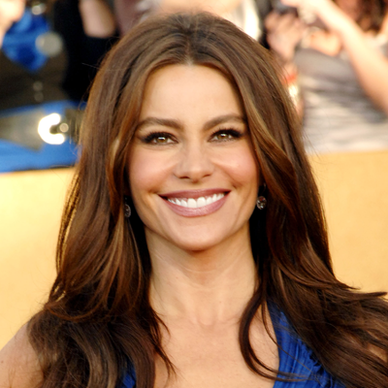
Das ist … ?
“Sofia Vergara” by Gregg Razzl licensed under All Rights Reserved. https://www.flickr.com/photos/53821021@N04/5426290314. Last accessed 7/14/2017.
Sofia Vergara

Slide 10
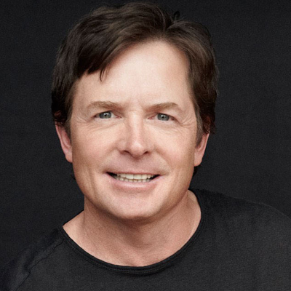
Das ist … ?
“Michael J. Fox là một diễn viên nổi tiếng mắc bệnh Parkinson từ khi còn trẻ” by Hồng Cúc Nguyễn licensed under All Rights Reserved. https://www.flickr.com/photos/155089886@N07/34775069193. Last accessed 7/14/2017.
Michael J. Fox

Slide 11
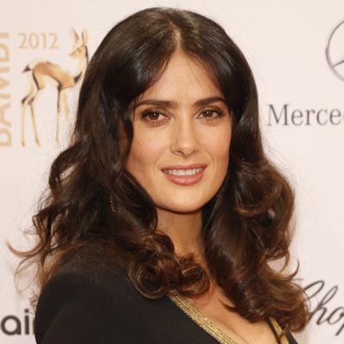
Das ist … ?
“Salma Hayek” by Hubert Burda Media licensed under CC BY NC SA 2.0. https://www.flickr.com/photos/hubertburdamedia/8208865115. Last accessed 7/14/2017.
Salma Hayek

